Slide 1


Project 2 - Creating Database in MYSQL
Natanael Pitoun - Ferdinand Leube – Edgar Tomé

Slide 2
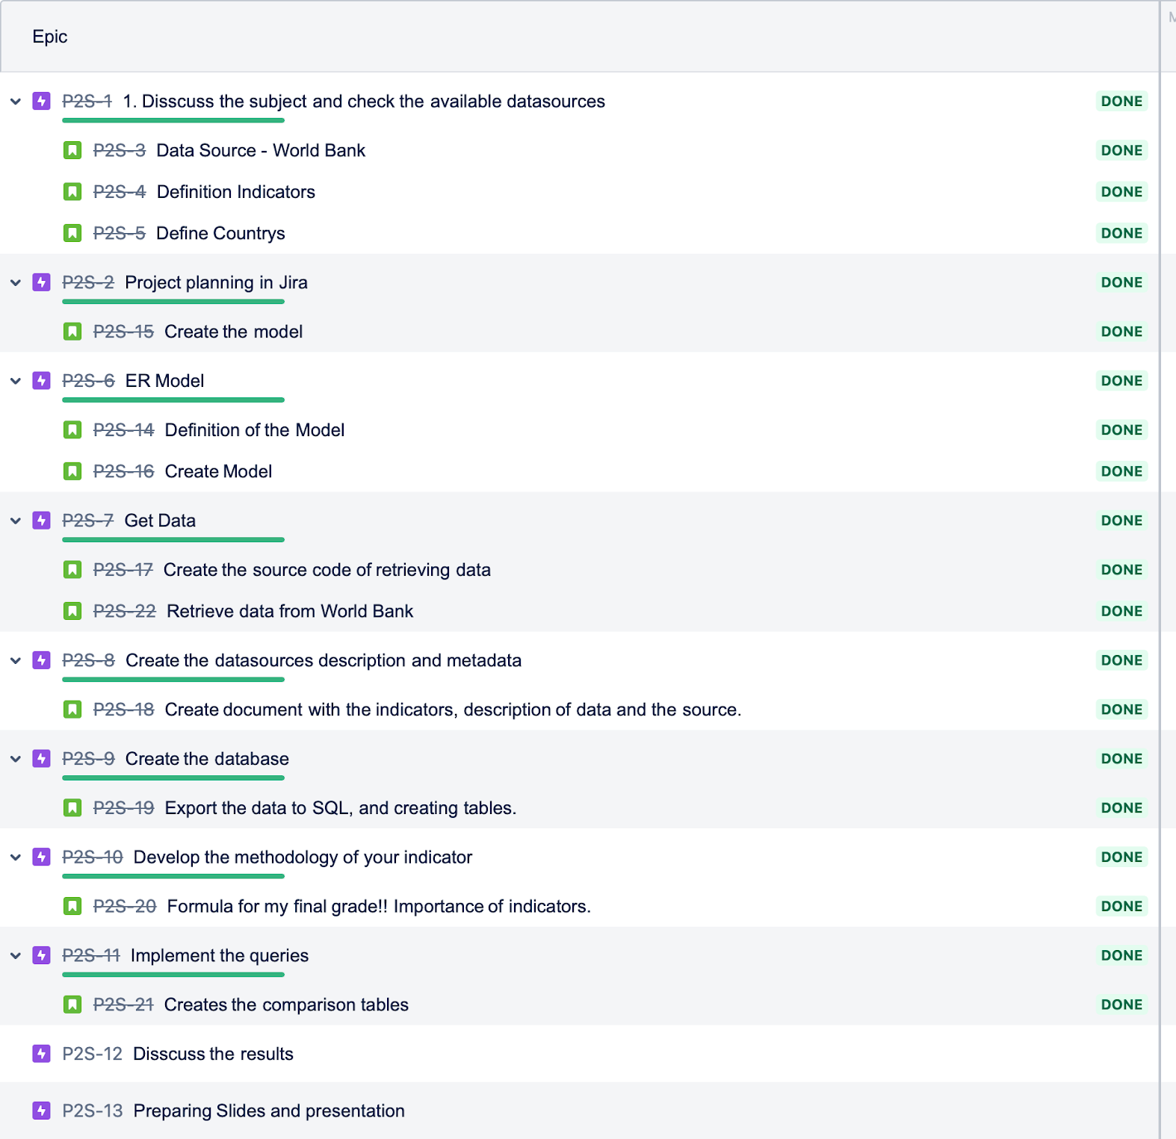
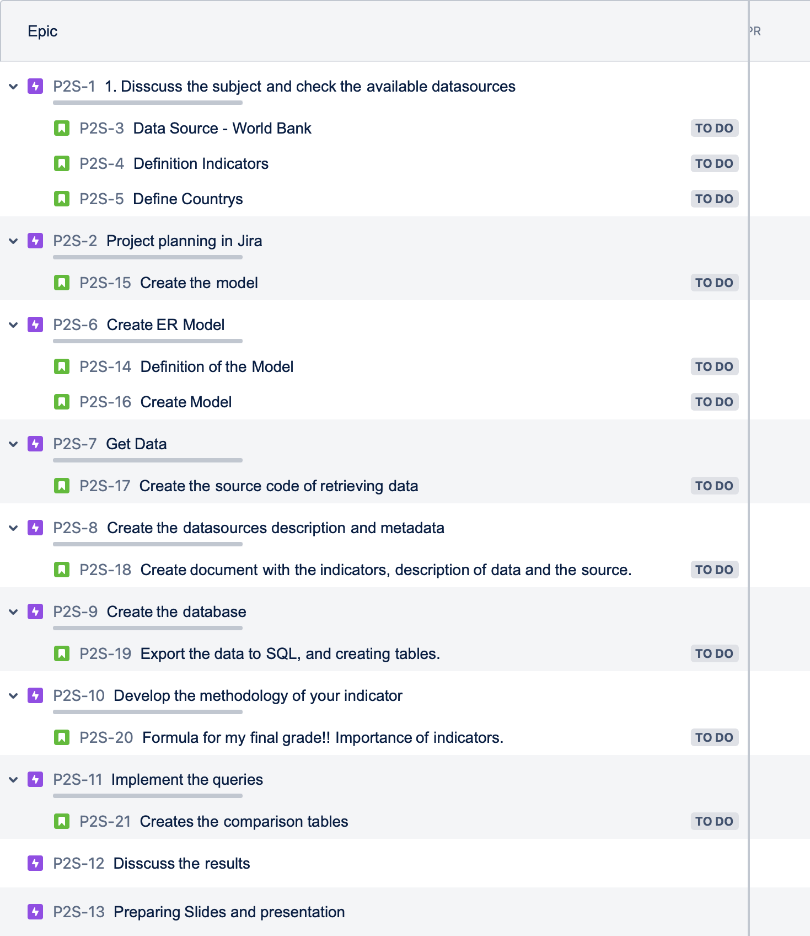
Project 2 - Creating Database in MYSQL
Planning - Jira
Final
Start

Slide 3
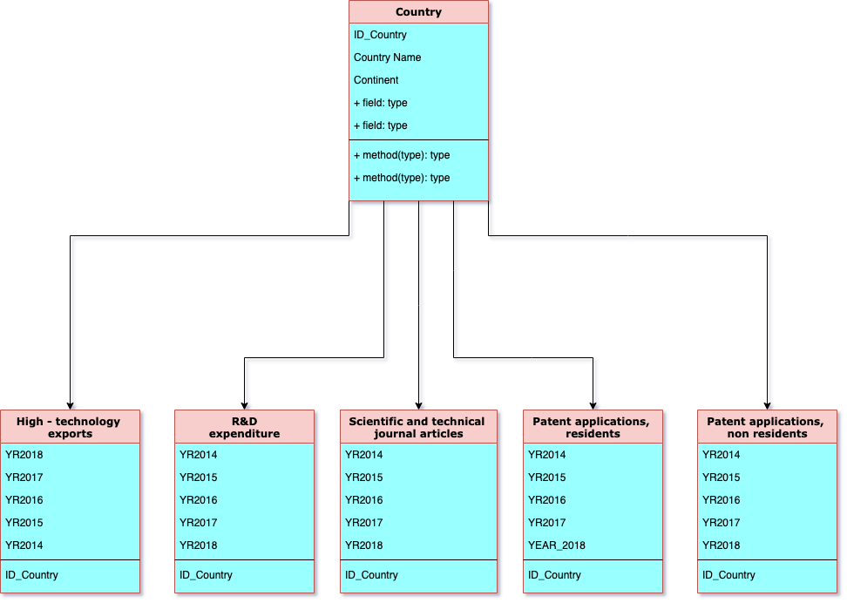
Project 2 - Creating Database in MYSQL
ER Model

Slide 4
Project 2 - Creating Database in MYSQL
Descripton of the Database
We created a composite indicator from R&D and economic statistics.
The data was scraped from the World Bank database via an API wrapper.
Our composite indicator was made using the following:
Research and development expenditure (% of GDP)
High-technology exports (% of manufactured exports)
Scientific and technical journal articles
Patent applications, residents
Patent applications, non-residents
The 10 countries selected are European with the addition of the US, Japan, and Israel as outliers for comparison.
We attempted to screen for a contrast between Southern & Northern Europe.

Slide 5
Project 2 - Creating Database in MYSQL
SQL – Script - Queries
Creation of database
Creation of tables of database
Import of data obtain via an API wrapper
Combined data of Patent Applications
Normalize Data
Application Indicator Formula for technology in the year 2014, for the countries in study

Slide 6
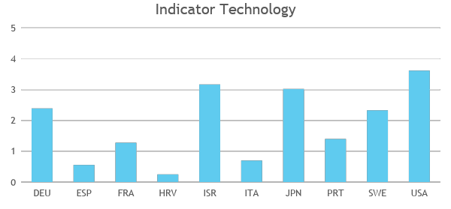
The Composite Indicator In itself
The composite indicator was based on a arbitrary hunch downgrading the important of patents and giving more weight to investment. We observe a clear North/South distinction, though Portugal holds its place as an innovator in front of France.
Indicator formula = 0.5 X Pattents + 2 X R&D + Technical Journal + High Technology
From the 10 countries, the top 3 are USA, ISR and JPN for the year 2014.
The worse counties are HRV, ESP and ITA

Slide 7
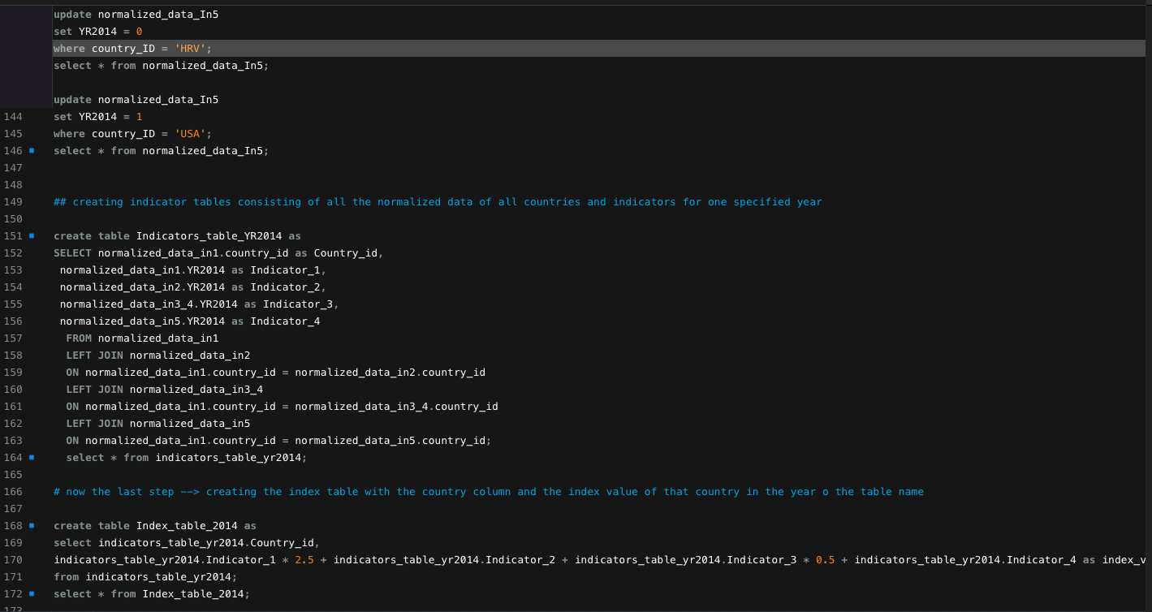
Project 2 - Creating Database in MYSQL
Demo

Slide 8
Project 2 - Composite Indicator
Questions
Q & A
TIME

Slide 9
Project 2 - Composite Indicator
The End
Thanks

